Slide 1
Attrition Study Mitigating Costs and Interruptions Through Data Science

Slide 2
Overview
Who Are We?
DDSAnalytics specializes in talent management solutions for Fortune 100 companies by leveraging data science to provide quantifiable and actionable data.
Why Does Attrition Matter?
Financial Impact: High turnover increases recruitment and training costs.
Estimated to cost between 6-9mo’s of impacted position salary⁽¹⁾.
Min: $6,500/event
Max: $180,000/event
Loss of Talent: Losing skilled employees affects productivity and knowledge retention.
Impact on Morale: Frequent departures can lower employee morale and engagement.
What Can We Do With This Data?
Identification: Identify potential employees at risk of leaving.
Intervention: Have conversations with employees on potential key factors and see how the company can mitigate them.
(1) The Cost of Replacing an Employee and the Role of Financial Wellness
Notes:
Discuss that Frito Lay has engaged DDS Analytics

Slide 3
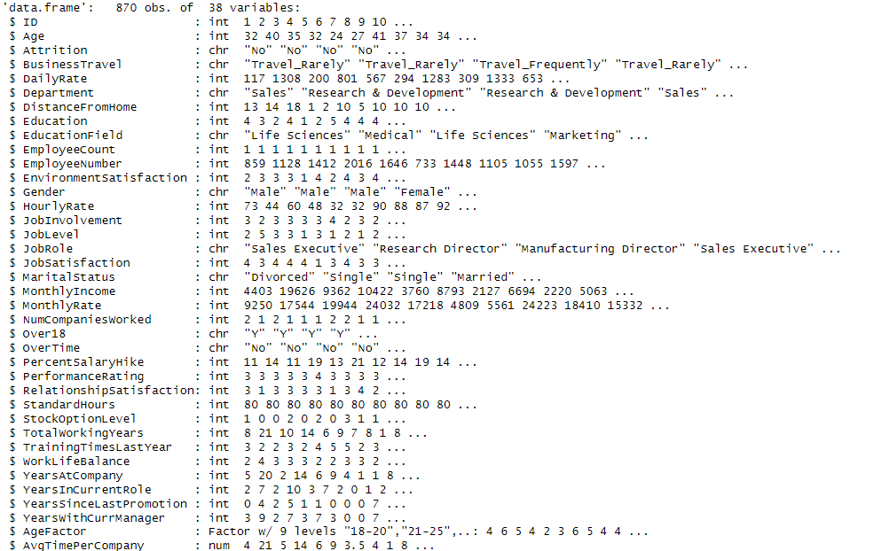
Dataset
What Data is Used?
Frito Lay’s HR department provided DDSAnalytics with data containing current and previous employees.
Overview
Total Columns: 38
Total Rows (each 1 employee): 870
Current employees: 630
Former employees: 140
No missing data.
Approach
We looked through the data, and can
start simplifying columns that are either not useful
or superseded by others. This helps simplify the
model and adds to overall efficiency.
Next Step
Analyze top 3 impactful variables related to attrition
from the remaining data.
Notes:
ID – cant use, all unique
Daily Rate, Hourly Rate, Monthly Rate – All don’t use due to the nature of some sales reps are commissioned based,etc we will look at Monthly Income as it should be the truth of what they earned
Over 18 – They are all over 18, not useful
Employee Number, unique, and number of employees is all 1
Standard Hours is all 80

Slide 4
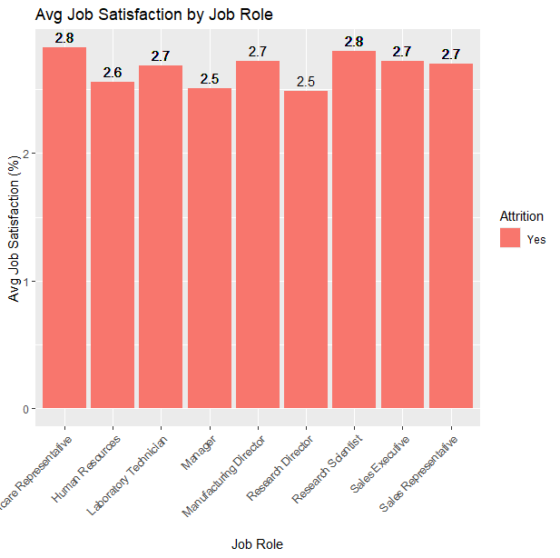
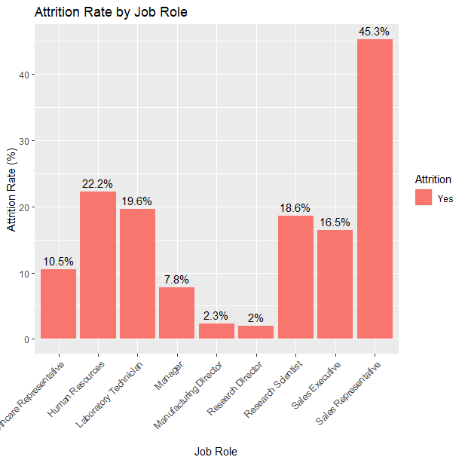
Modeling Goals: Why It Matters
Looking at job role specifics, we see different jobs roles are experiencing attrition at different rates.
When looking at employee feedback, you wouldn’t be able to tell likely due to bias, which is where the modelling can benefit the company.

Slide 5
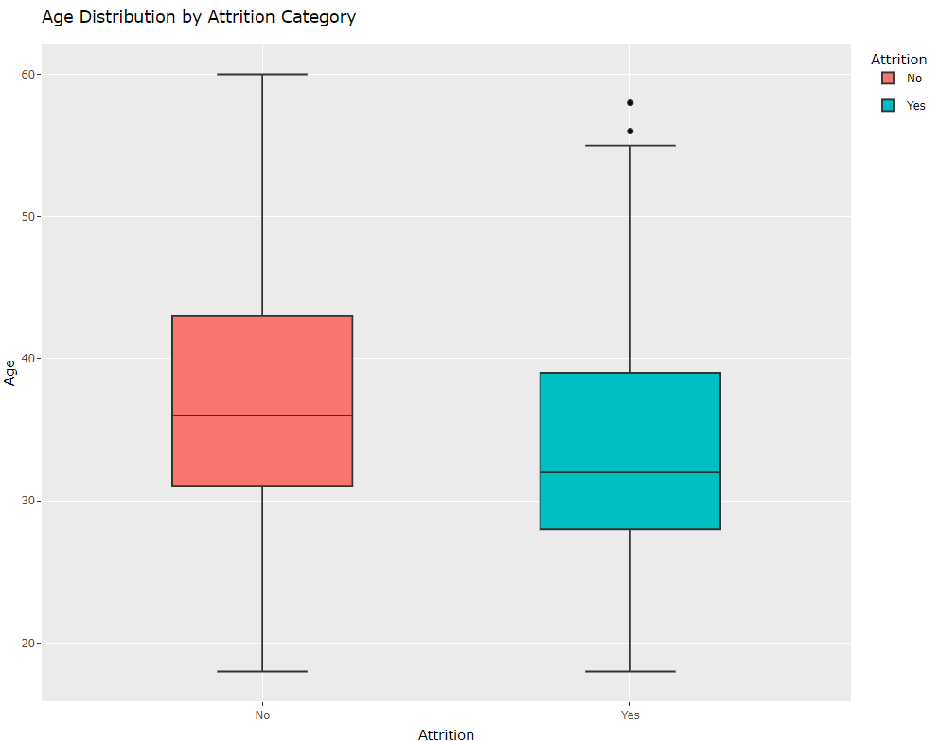
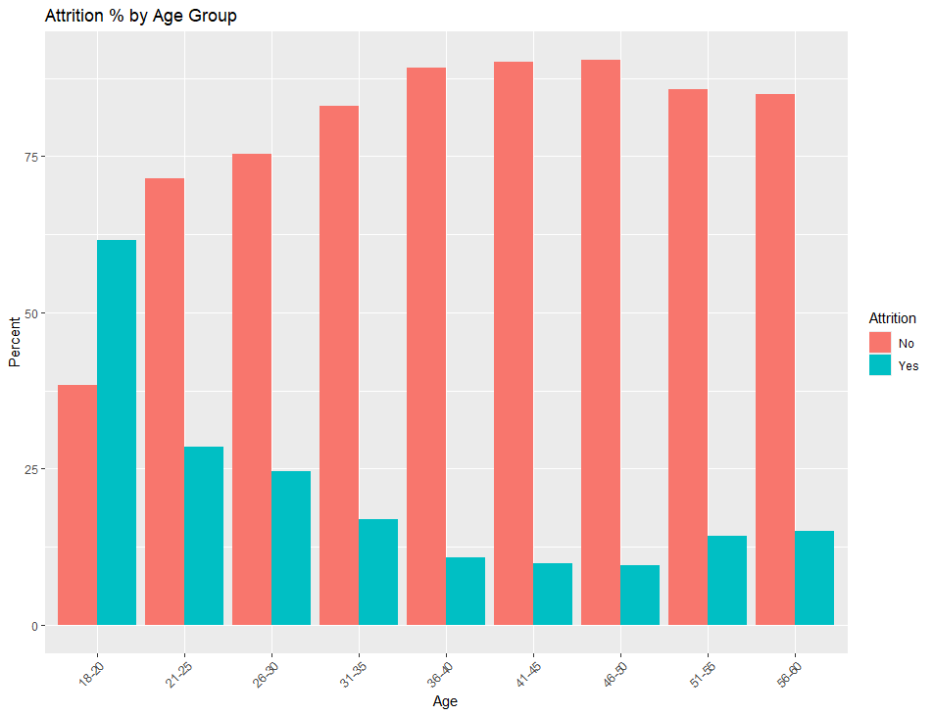
First Variable - Age
One of the top, if not the top contributor to attrition is Age.
From the graph we can see the median age of those who choose to leave is significantly younger than those that stay.
Furthermore, looking that the new graph, we can see the higher attrition rate by age category, highlighting the younger age ‘buckets’ having higher attrition.
Generally, younger people are just starting their career and are more susceptible to taking jobs with higher pay, which is the next factor we will look at.
Median(s)
Notes:
Add in at the end, that we performed a t-test and there is extremely strong evidence to suggest that the difference in mean age is greater than zero telling us that this is a valid

Slide 6
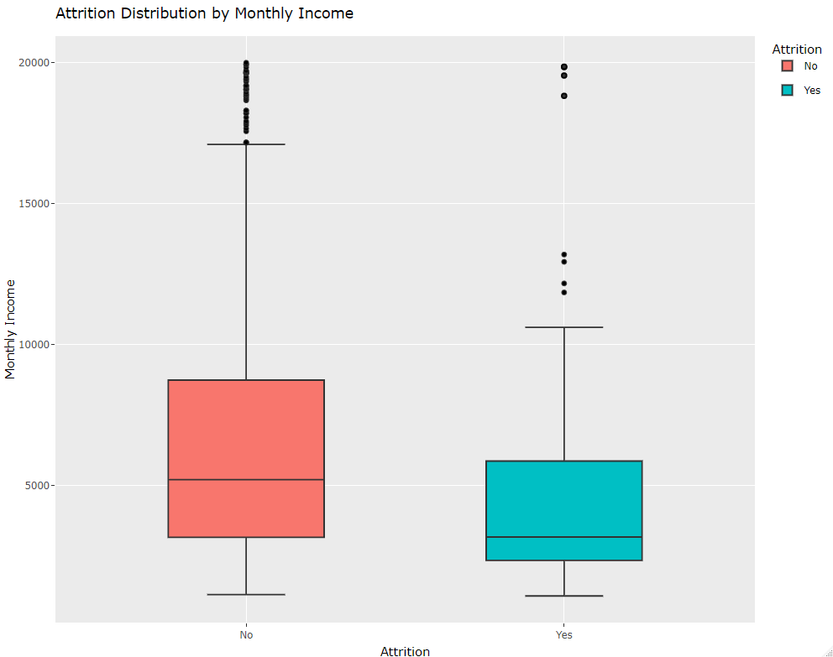
Second Variable - Pay
From the graph, employees that are leaving are being paid a median of $2,100/month less.
The distribution also shows that the majority are the lower paid individuals while there are some higher earning individuals choosing to leave.
Notes:
We also performed a t-test here and had a resulting p-value of 1millionth decimals chance. This indicates a very strong suggestion that the pay difference is a factor leading to attrition

Slide 7

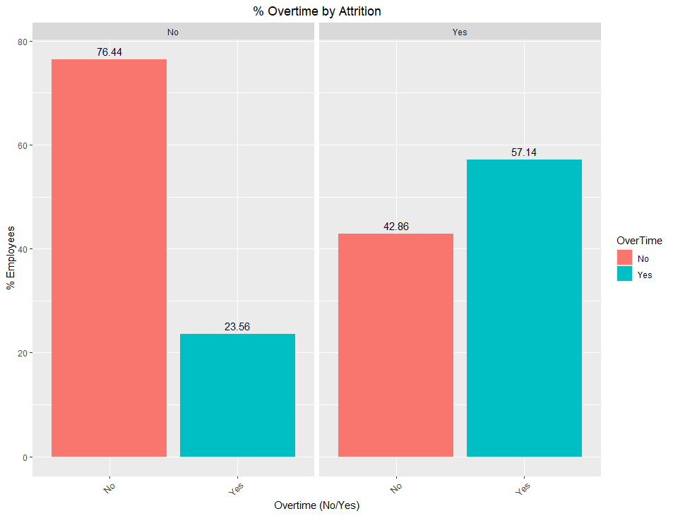
Third Variable - Overtime
From the graph on the right, we can clearly see that the relationship of employees that choose to leave are being asked to work overtime more frequently.
Next Steps:
Now that we have found our three variables, we will create, run, and compare models to estimate future attrition data.

Slide 8
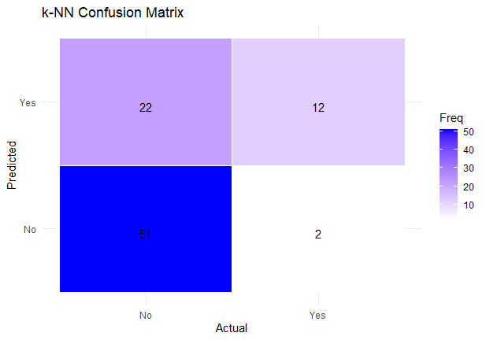
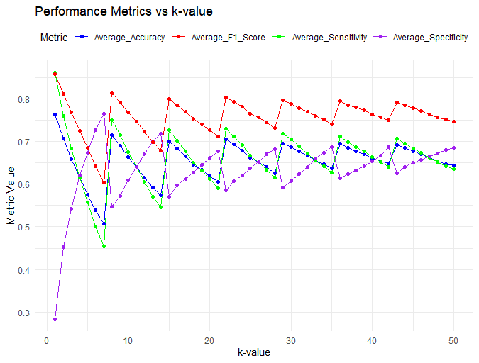
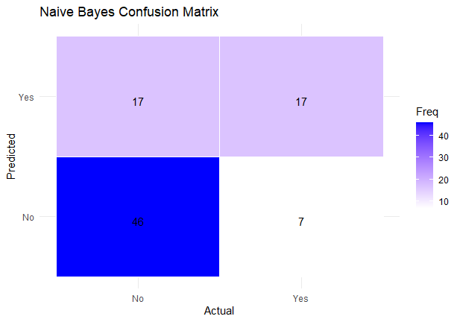
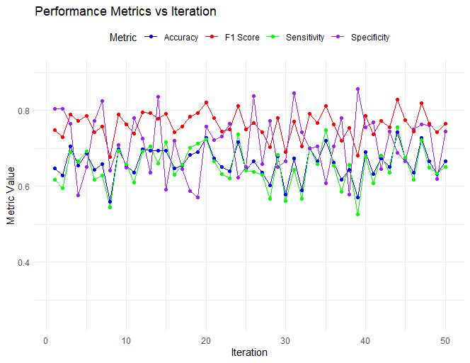
Initial Modeling Comparison
k-NN Model
The first model we implemented was a k-NN model.
The second model we looked at was Naïve Bayes model.
What does this look like in reality?
Naïve Bayes Model
Notes:
For the k-NN model, we did 30 iterations over 50 k values until we saw the means of the metrics for each k value start to stabilize. This was an effort to tune the k value on the given dataset.
Then we looked at dropping the threshold of the percentage value that it would take to identify a potential events of attrition. The threshold adjustment is due to the weights of the dataset, with 84% being non-attrition employees, the k-NN model will likely see those first so we have to tune the model to look a little harder for the folks that did decide to leave which is the reason for including that lower threshold
Looking at the accuracy, that tells how good we are about being correct, which is around a 65% accuracy rate. Moving on to the sensitivity, tells us how good we are at identifying people in this case that are not going to leave, and we see 66% here. The next stat, is the specificity, which tells us how good we are at identifying the people that do want to leave, a 63% rate there. So putting all of those together, we can say that over 60% of the time, we are going to correctly identify the path people are choosing and that would give us leverage on intervening and potentially prevent that employee from leaving, saving the company money. Now the last statistic F1 is the models total accuracy, and is preferred over just accuracy since the score includes accuracy on the positive class and the models ability to find all of those values.
The second model we looked at was the naïve bayes model. While this one doesn’t requite k-value tuning, we still elected to run multiple iterations of it to see the spread of predictions using the same threshold as the knn model.
As you can see from the table, the Naïve bayes does better wholistically at predicting true falses and that is evident in the specificity.

Slide 9
Conclusion, Q&A
Potential Savings?
From the data, the average monthly pay of all employees is $6,400, implying the average cost of an employee leaving ~$50K (x7.5mo). Assuming the average intervention cost is 10% of that: $5K
Questions?
For further details please reach out:
Blake Armstrong
armstrongb@mail.smu.edu
Prior to Modeling
Post Modeling
Notes:
Thank you for coming to our presentation, we look forward to continuing to work with Frito Lay as we implement this model for future use. I will now be taking questions.

